Slide 1
Bankruptcy Prevention
Presented by:
Shivangi Sharma

Slide 2
Bankruptcy Prevention
Business Objective
Objective:
The goal is to predict the likelihood of a business going bankrupt using various company features.
This is a binary classification project where the target variable indicates bankruptcy (1) or non-bankruptcy (0).
Definition of Bankruptcy Prevention:
Bankruptcy prevention involves identifying and mitigating factors that could lead to a business's financial failure, allowing for timely interventions to avoid insolvency.

Slide 3
Data Overview & Features
Data Overview:
The dataset includes information on 250 companies, each described by 7 features related to risk and operational metrics.
Features:
Industrial Risk
Management Risk
Financial Flexibility
Credibility
Competitiveness
Operating risk
Class (Target)

Slide 4
Data Overview & Features
Slide 3: Methodology and Deployment
Methodology:
We performed Exploratory Data Analysis (EDA) to understand the data and identify patterns.
Feature Engineering was conducted to create meaningful variables.
Various algorithms were tested, including Decision Trees, which was selected for deployment due to its interpretability and performance.
Deployment:
The Decision Tree model is implemented to predict the bankruptcy status of businesses.
This model can be used in business decision-making processes to identify high-risk companies and take preventive actions to avoid bankruptcy.

Slide 5
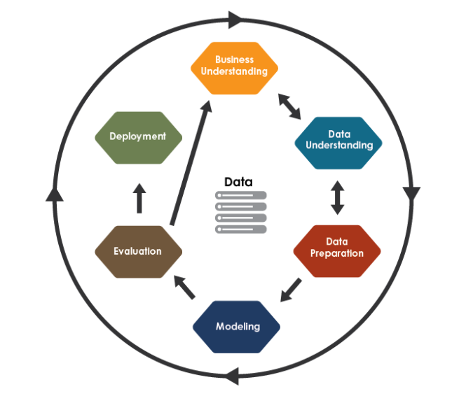
Project FLow

Slide 6
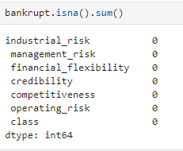
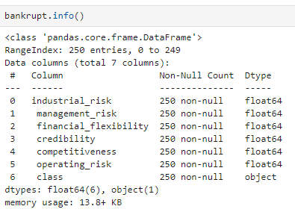
Exploratory Data Analysis and Visualization
1. Data Overview
Structure and Descriptive Statistics: The dataset's structure was inspected using info() and describe(), which showed no duplicate entries or null values, ensuring data integrity.

Slide 7
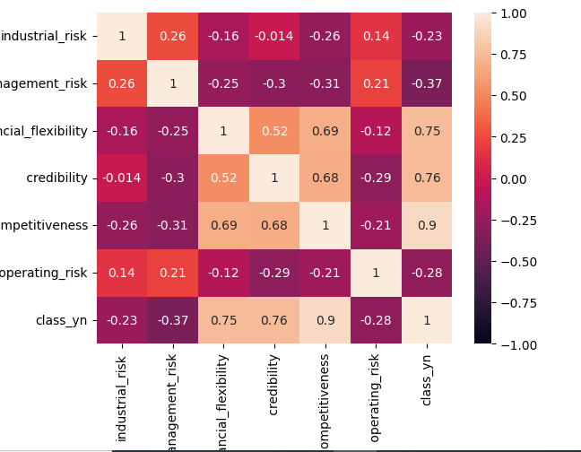
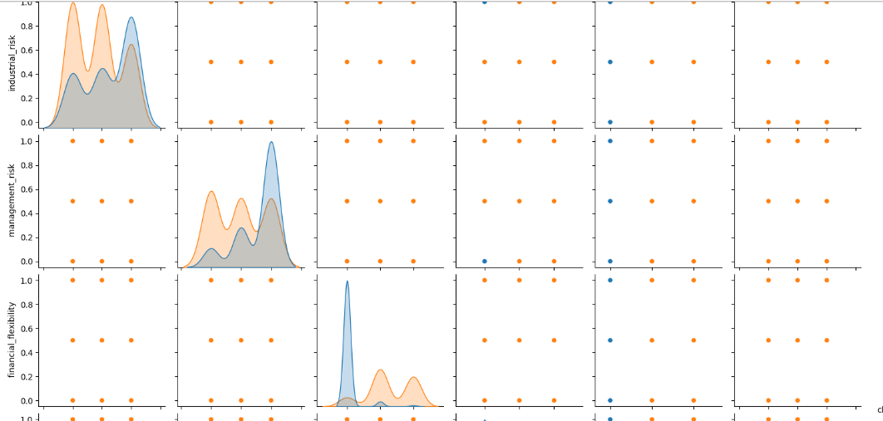
Exploratory Data Analysis and Visualization
2. Visualization and Correlation Analysis
Pair Plot: Created pair plots for numerical features to explore relationships and distributions, helping to identify patterns.
Correlation Matrix: Generated a correlation matrix and heatmap, revealing that "Air Temperature" and "Process Temperature," as well as "Rotational Speed" and "Torque," are highly correlated.

Slide 8
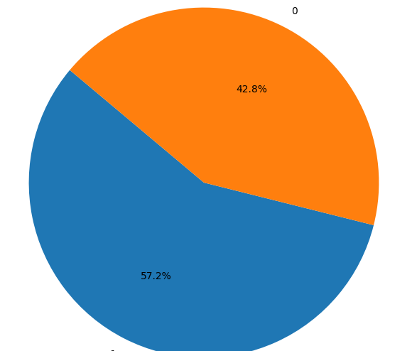
Exploratory Data Analysis and Visualization
3. Distribution Analysis
Analysed the distribution of Bankruptcy status with pie chart and bargraphs.

Slide 9
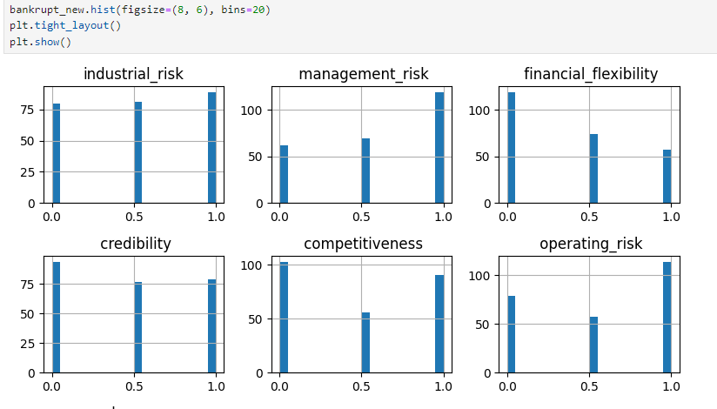
Exploratory Data Analysis and Visualization
4. Histogram:
Histogram was created to look into each variable to look at the distribution.

Slide 10
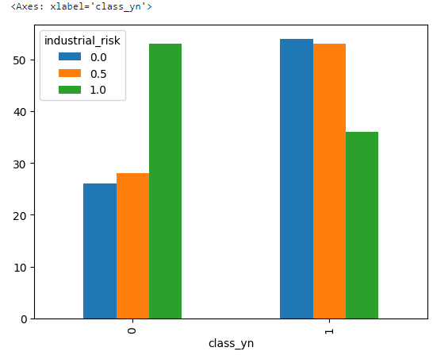
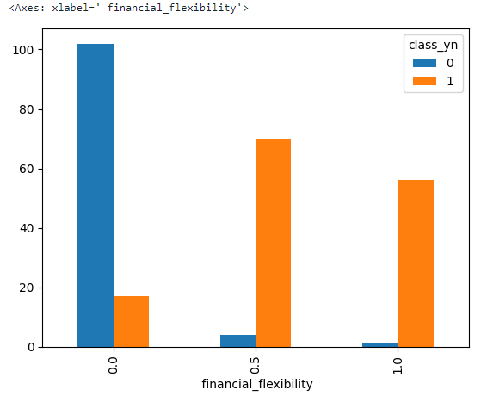
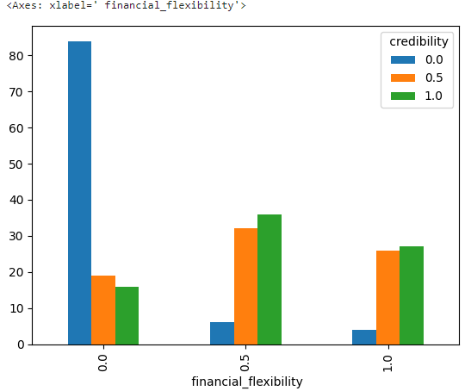
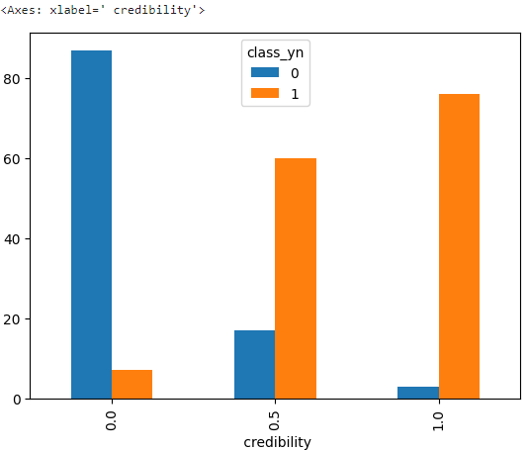
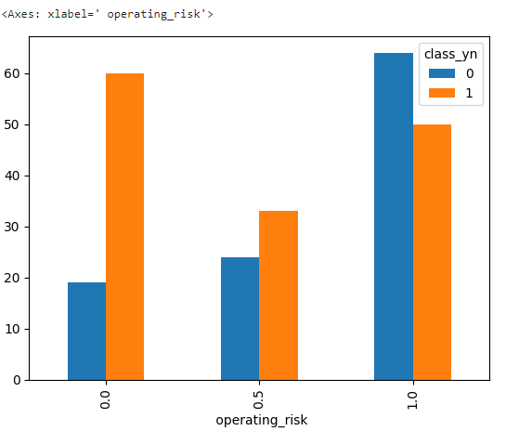
Exploratory Data Analysis and Visualization
Crosstab was created for each x variable with respect to the y variable(class_yn) to display the frequency distribution of variables and to understand the relationship between the variables.

Slide 11
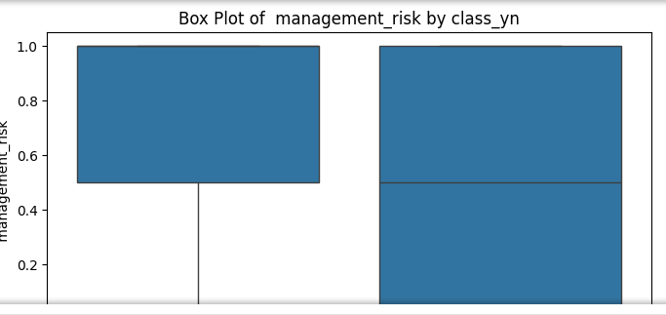
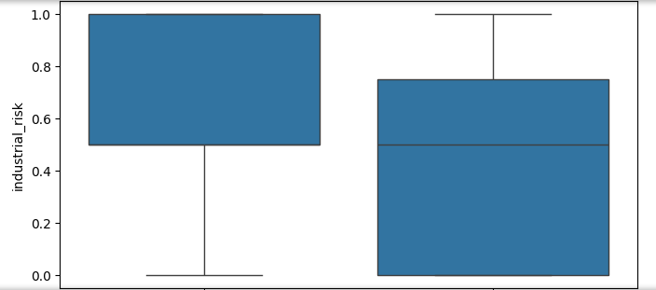
Exploratory Data Analysis and Visualization
6. Outlier Analysis
Histograms and Box Plots: Created histograms and box plots for numerical columns to examine distributions and identify outliers.

Slide 12
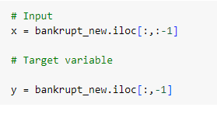
Feature Engineering
1. Creation of New Features
x : Introduced a new feature x [Input]
y : Introduced a new feature y [Target Variable]
Action: Separated the dataset into features (X) and target variable (y), with y .
Purpose: Prepares the data for supervised learning, where the model learns to predict the target based on the features.

Slide 13
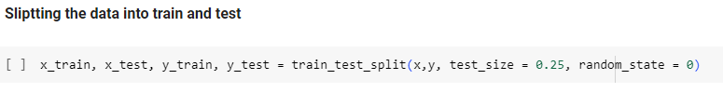
Feature Engineering
2. Splitting the data into train and test
Train Test Split : To have unknown data points to test the data rather than testing with the same points with which the model was trained. This helps capture the model performance much better.
Action: Split the data into training (80%) and testing (20%) sets.
Purpose: Provides data for training the model and evaluating its performance on unseen data to ensure generalization.

Slide 14
Model Building
Model Selection:
Decision Tree: Chosen for its ability to handle complex relationships in data and robust performance across various metrics.
Other Models Evaluated:
Logistic Regression, SVM, Decision Tree, KNN, Random Forest: Each model was trained and evaluated using classification reports to assess their performance in predicting Bankruptcy or Non-Bankruptcy.

Slide 15
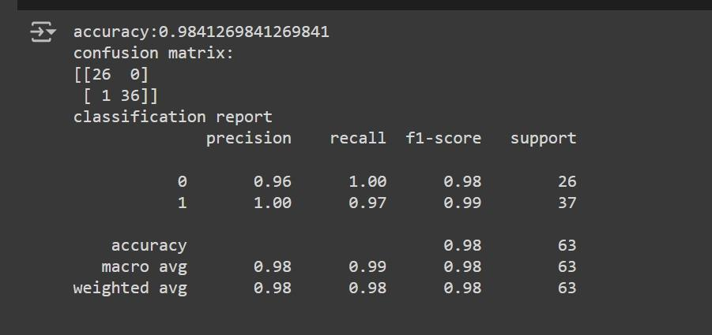
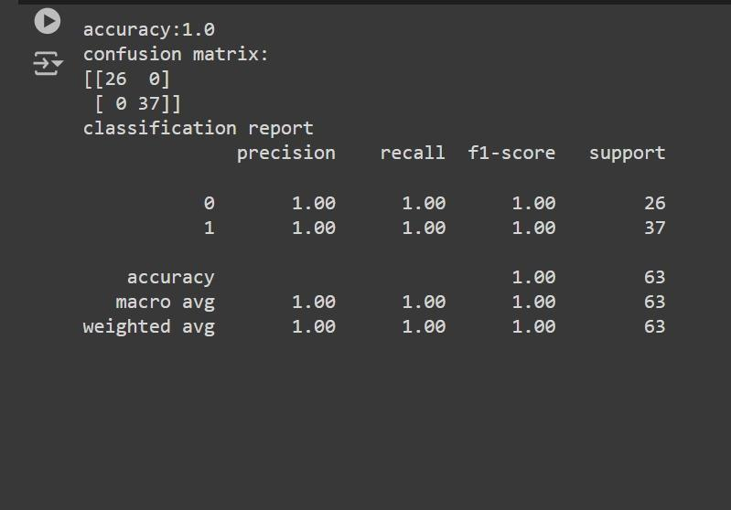
Model Building
Evaluation Metrics:
Classification Report: Used to analyze precision, recall, F1-score, and accuracy of each model, providing insights into their strengths and weaknesses.

Slide 16
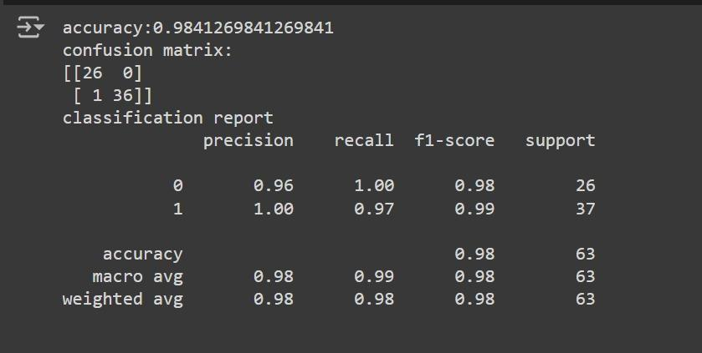
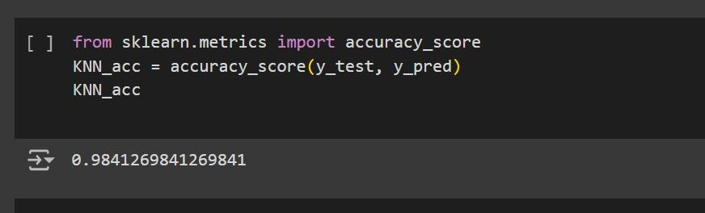
Model Building

Slide 17
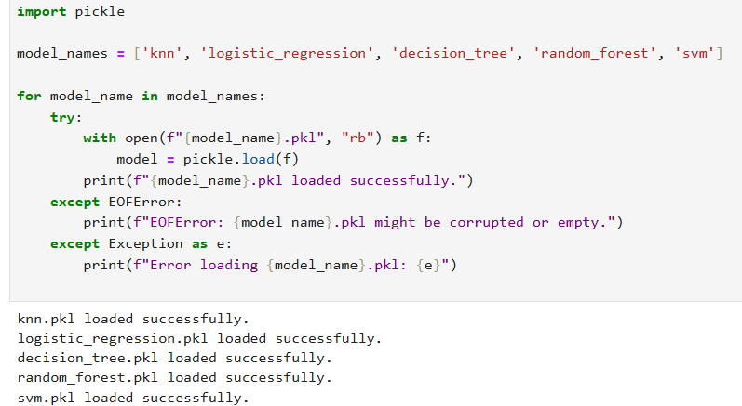
User Deployment and Prediction Model
Streamlit Application:
A Streamlit application was developed to provide an interactive interface for predicting bankruptcy using the trained model.
Pickle Files:
The trained model is saved as a pickle file to efficiently store and load the model for future use without retraining.

Slide 18

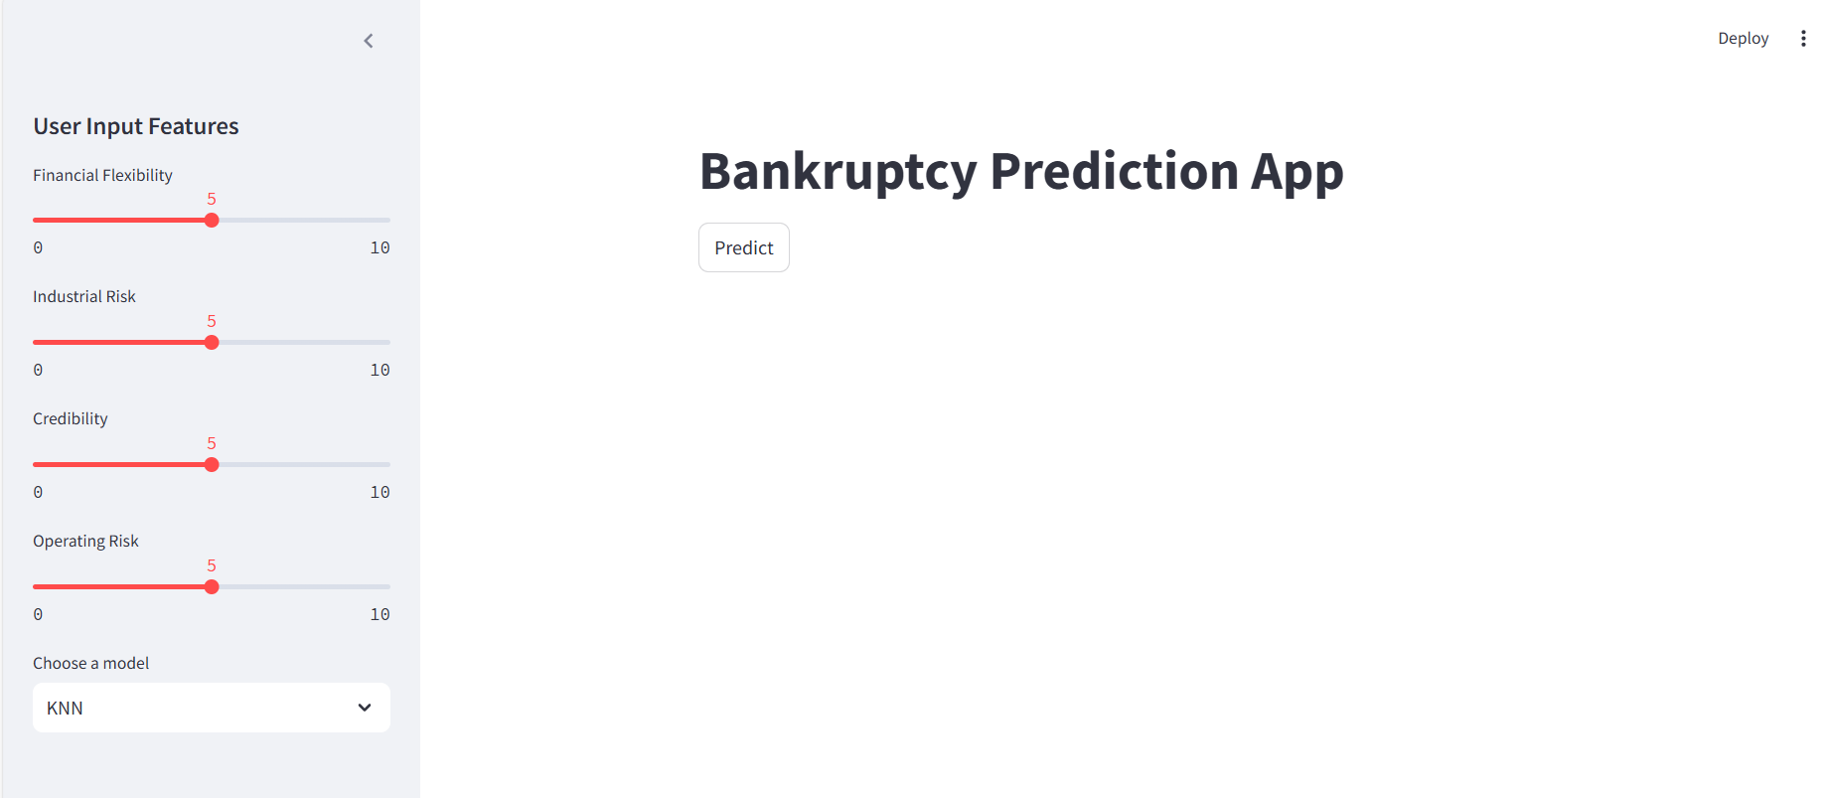

Slide 19
Thank you!

